Slide 1
RBC – for Education
2019330001 류시모

Slide 2
KIDS ARE DROPPING OUT!!
2018 Korea SAT, Ratio of score with 40points or less

Slide 3
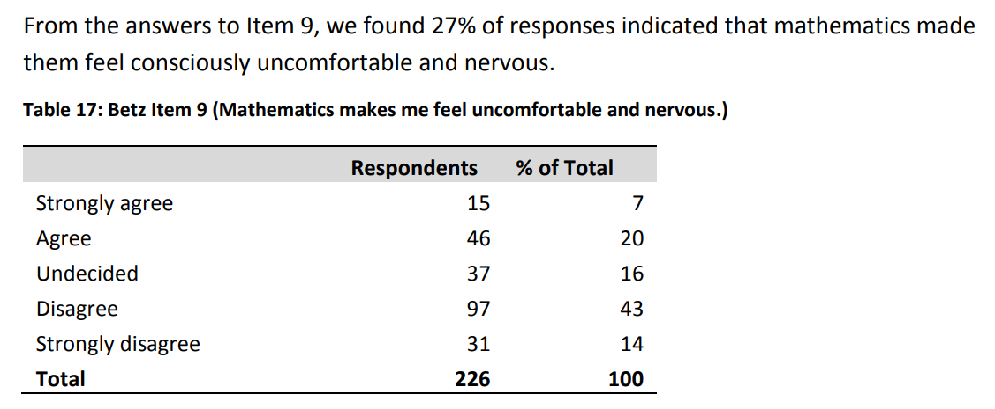



Slide 4
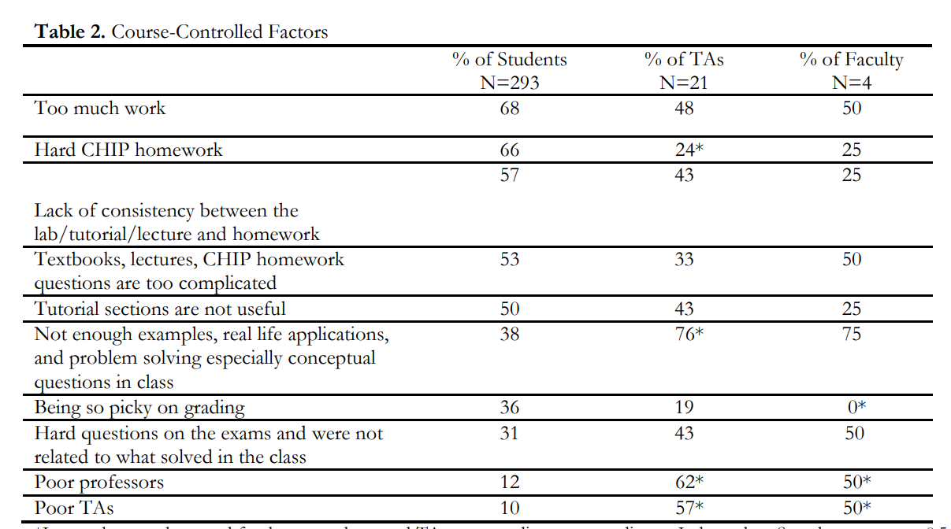











Slide 5
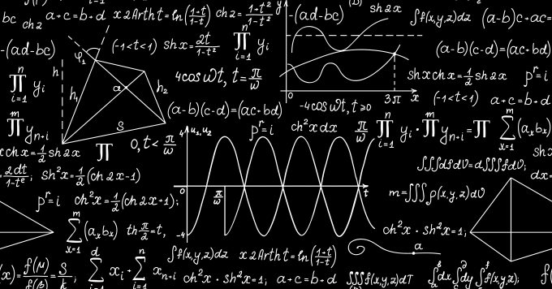
We need better education source fir math & physics

Slide 6
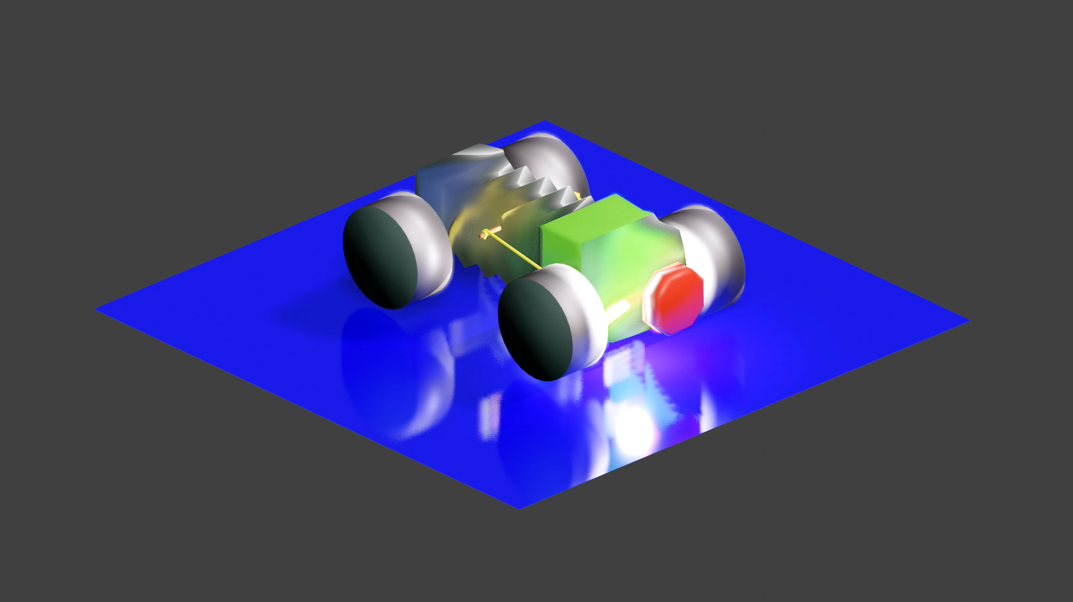
Rubber Band Car – the new form of education

Slide 7
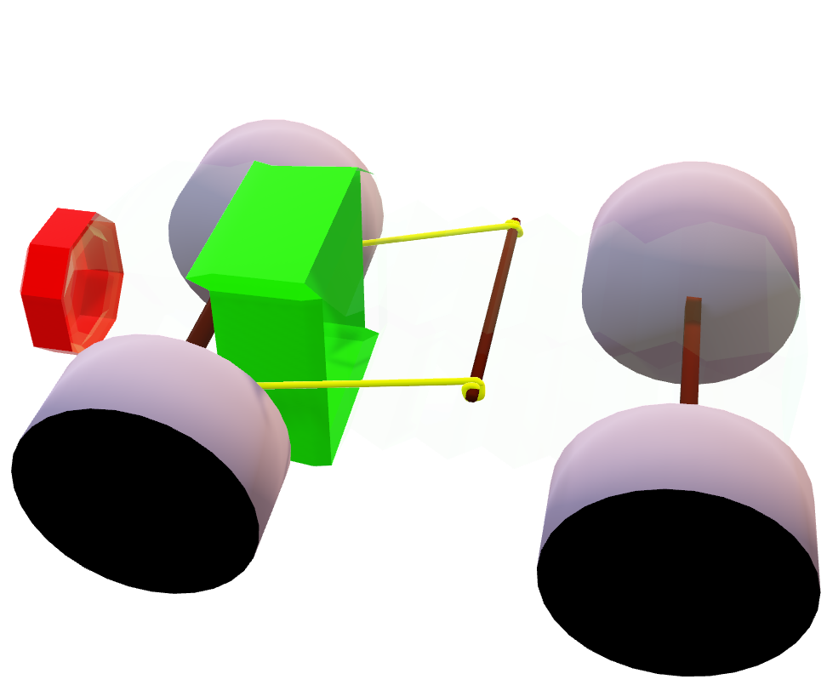
I. What is it? What does it do?
toy rubber band car that is made of daily used materials, that are malleable and deconstructable.

Slide 8
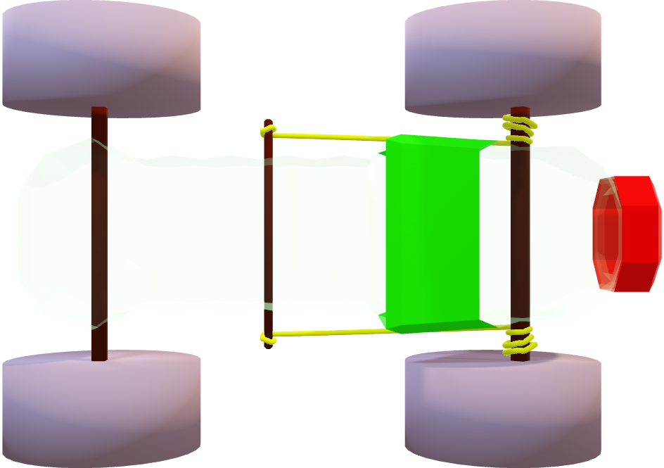
I. What is it? What does it do?
2. Materials:
Rubber Band, Plastic body & Sticks
Soldering iron:
transform the toy into whatever shape student desire.

Slide 9
I. What is it? What does it do?
3. Functionality & usage
3Ms
Malleability:
Every component are easily bent & fully deconstructable.
Measurability:
Ruler & spring balance are included
Machinery:
Provides simple ideas for mechanical components and engineering

Slide 10
How will this help our students…?

Slide 11
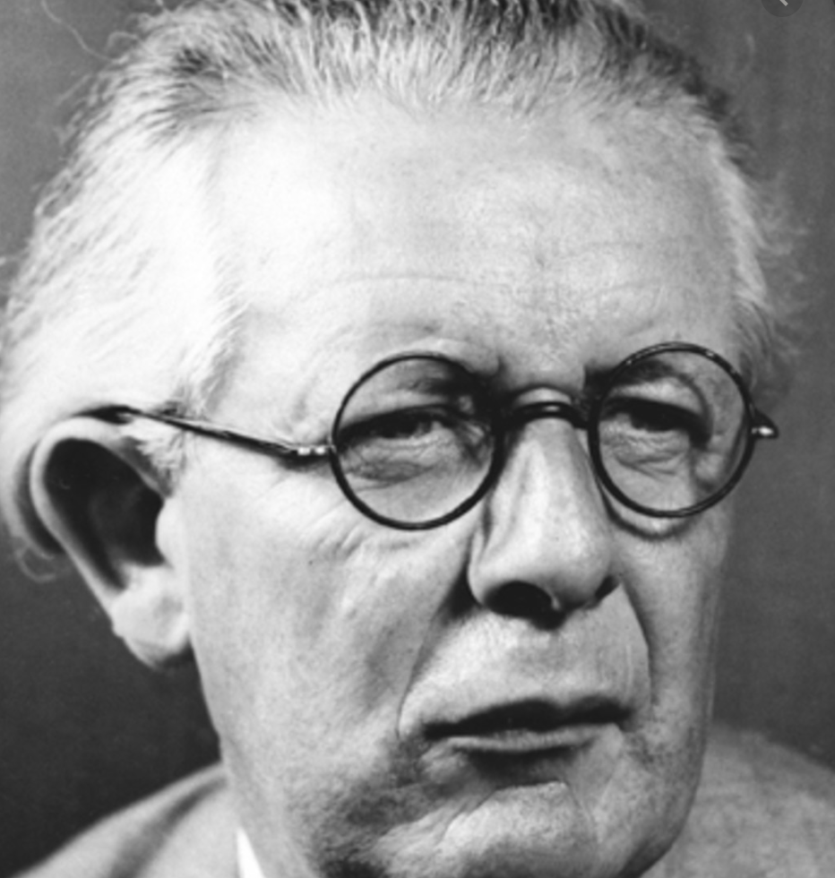
II. Problems with on – paper education
How psychologists explain our method of “learning”
Piagetian Idea of learning & developing
Assimilation & Accommodation
Learn by acting, fiddling, transforming…

Slide 12
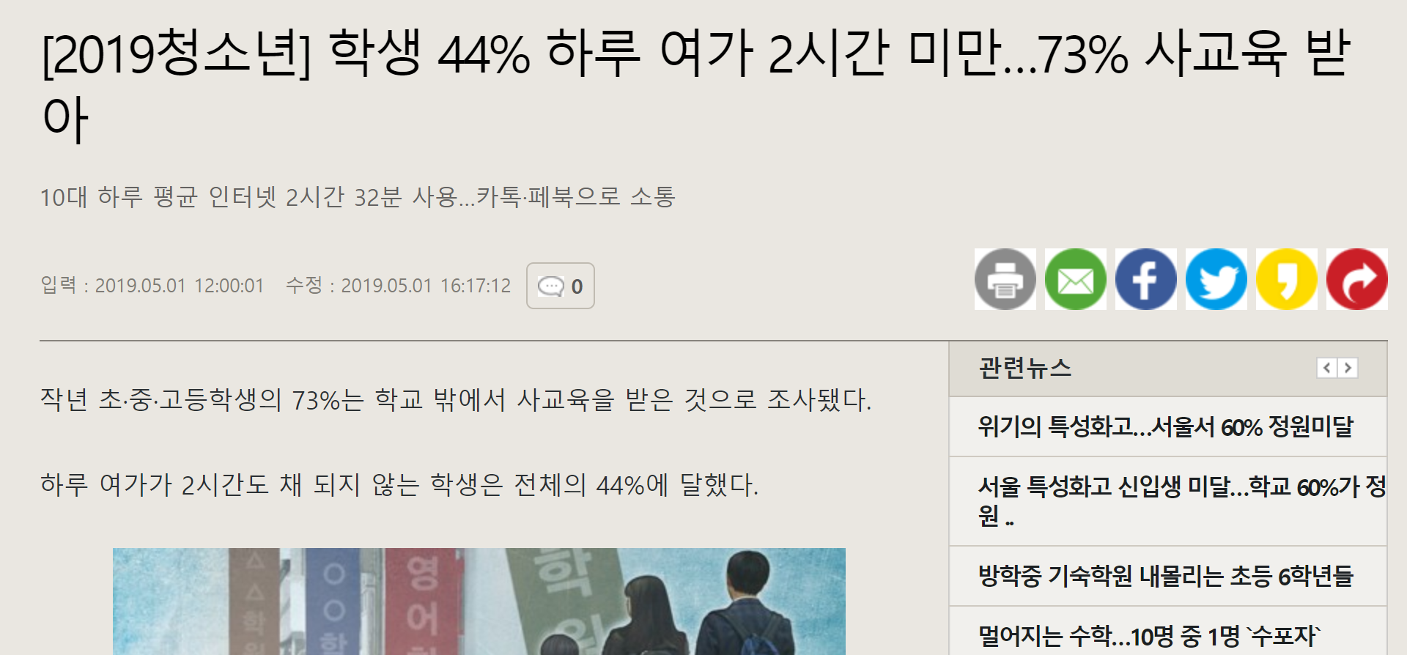
II. Problems with on – paper education
2. But, where are theses stages exactly in modern Korean – education?
_ seems to be none.

Slide 13
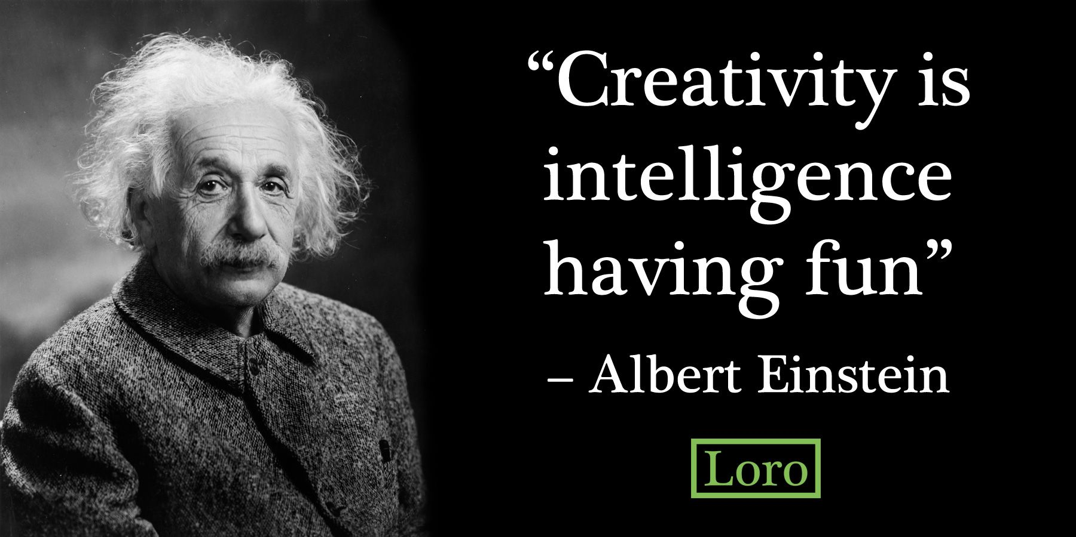
II. Problems with on – paper education
Scores and grades are not everything!
Research have shown that there was negative correlation (-0.12) with creativity and score in case of physics grade [3]
Quote by Albert Einstein
"Imagination is more important than knowledge. Knowledge is limited. Imagination encircles the world.“

Slide 14
III. How exactly will it benefit?
3Ms :
Malleability: Piaget’s Idea of true “learning”
Measurability: Enables technical analysis
Machinery: Enables more than just math & physics.

Slide 15
III. How exactly will it benefit?... Therefore…
Students & children will “intuitively learn” the machinery of the basic physical toy.
Use ruler & spring balance will make enable analytical
Experiments possible.
Guidelines & Possible Examples:
linear regression analysis for measuring elasticity constant of the rubber band.
heat distribution’s transformation, heat equation & regression analysis.

Slide 16
Summary:
There is major problem in education of Stem field
Our products will be helpful
3. Please considering buying our products.

Slide 17
[1] Ornek, F., Robinson, W. R., & Haugan, M. P. (2008). What Makes Physics Difficult?. International Journal of Environmental and Science Education, 3(1), 30-34.
[2] Johnston-Wilder, S., Brindley, J., & Dent, P. (2014). A survey of Mathematics Anxiety and Mathematical Resilience among existing apprentices. London: The Gatsby Foundation.
[3] Sierwald, W. (1989). Creative hochbegabung-Identiflkation, entwicklung undforderung kreativer hochbegabter (Creative talent: Identification, development, and demand). In Paper presented at the 2nd Meeting of the Section Educational Psychol¬ ogy of the German Psychological Society.

